Slide 1
WELCOME
Volunteerism @ HAIS Meeting
Magnet Coordinator
Ms. Erica Alderete

Slide 2
AGENDA
Introduction
Fostering the Service Mindset
The HAIS Experience
Innerview
Campus Service Clubs
11th Grade Capstone
Get Involved

Slide 3
More than Academics
Beach Clean Up
Houston Marathon
Black History Month
Hispanic Heritage Month
Welcome Back
Art Car
11th Grade Capstone
Wreaths Across America
SUSO
Lunar New Year

Slide 4
HAIS Mission Statement
Through international studies, a personalized environment, and college preparatory curriculum, the Houston Academy for International Studies will prepare students for active roles as global citizens.

Slide 5
Fostering a Service Mindset
A small effort = A large impact
At HAIS, we believe that students learn about themselves and their place in the larger global community through works of service. As such, we foster a culture where volunteering is encouraged and recognized.
Volunteering is a great way to develop a service mindset because you are treating each opportunity as a mutual learning experience. Students will:
Help others
Learn from others
Expand their perspective of the world
Be a part of something bigger than themselves
"It begins with the natural feeling that one wants to serve, to serve first.
Then conscious choice brings one to aspire to lead."
- Robert Greenleaf

Slide 6
The HAIS Experience
9th Grade
10th Grade
11th Grade
12th Grade
Students start their journey at HAIS learning about themselves and their connection globally.
Freshman are eligible to join the HAIS Interact Club, a social and service club sponsored by the Rotary Club of Houston.
Students continue their journey and begin diving into personal areas of interest.
Sophomores are able to join the National Honor Society, an academic and service club.
Students participate in the 11th Grade Service Learning Capstone in their area of interest.
Students put learning into practice at their year-long internship which culminates with a capstone project.
Students that earn 200 hours of service graduate with a volunteer chord.
Notes:
Learning happens through embedded coursework, field trips, and campus festivals.

Slide 7
Our Partnership with Innerview
Notes:
We have partnered with Innerview, a free service to track volunteer hours using the United Nations 17 Sustainable Goals as a focus. Students will be creating a personalized profile during their AVID or Advocacy class. These profiles can follow them even after their graduation date.

Slide 8
Earning Volunteer Hours

Slide 9
Service Clubs @ HAIS
Rotary International Interact Club
National Honor Society
Short for international action, Interact clubs bring together young people ages 12-18 to develop leadership skills and learn about themselves while discovering the power of Service Above Self.
Interacters connect with leaders in their community and around the world to:
Take action to make a difference in your school and community
Discover new cultures and promote international understanding
Become a leader in your school and community
Have fun and make new friends from around the world
Who can join?
Freshman through seniors interested in helping their community.
The National Honor Society is a program for Juniors and Seniors to volunteer and connect with their community. Each year, the students are required to volunteer a certain amount of hours. They have to represent the pillars of leadership, character, citizenship, service, and scholarship.
Who can apply to join?
Be a current sophomore or junior
Have a 3.75 (weighted) GPA
Maintain good citizenship
Submit a complete application during the application window. (Due April 7)

Slide 10
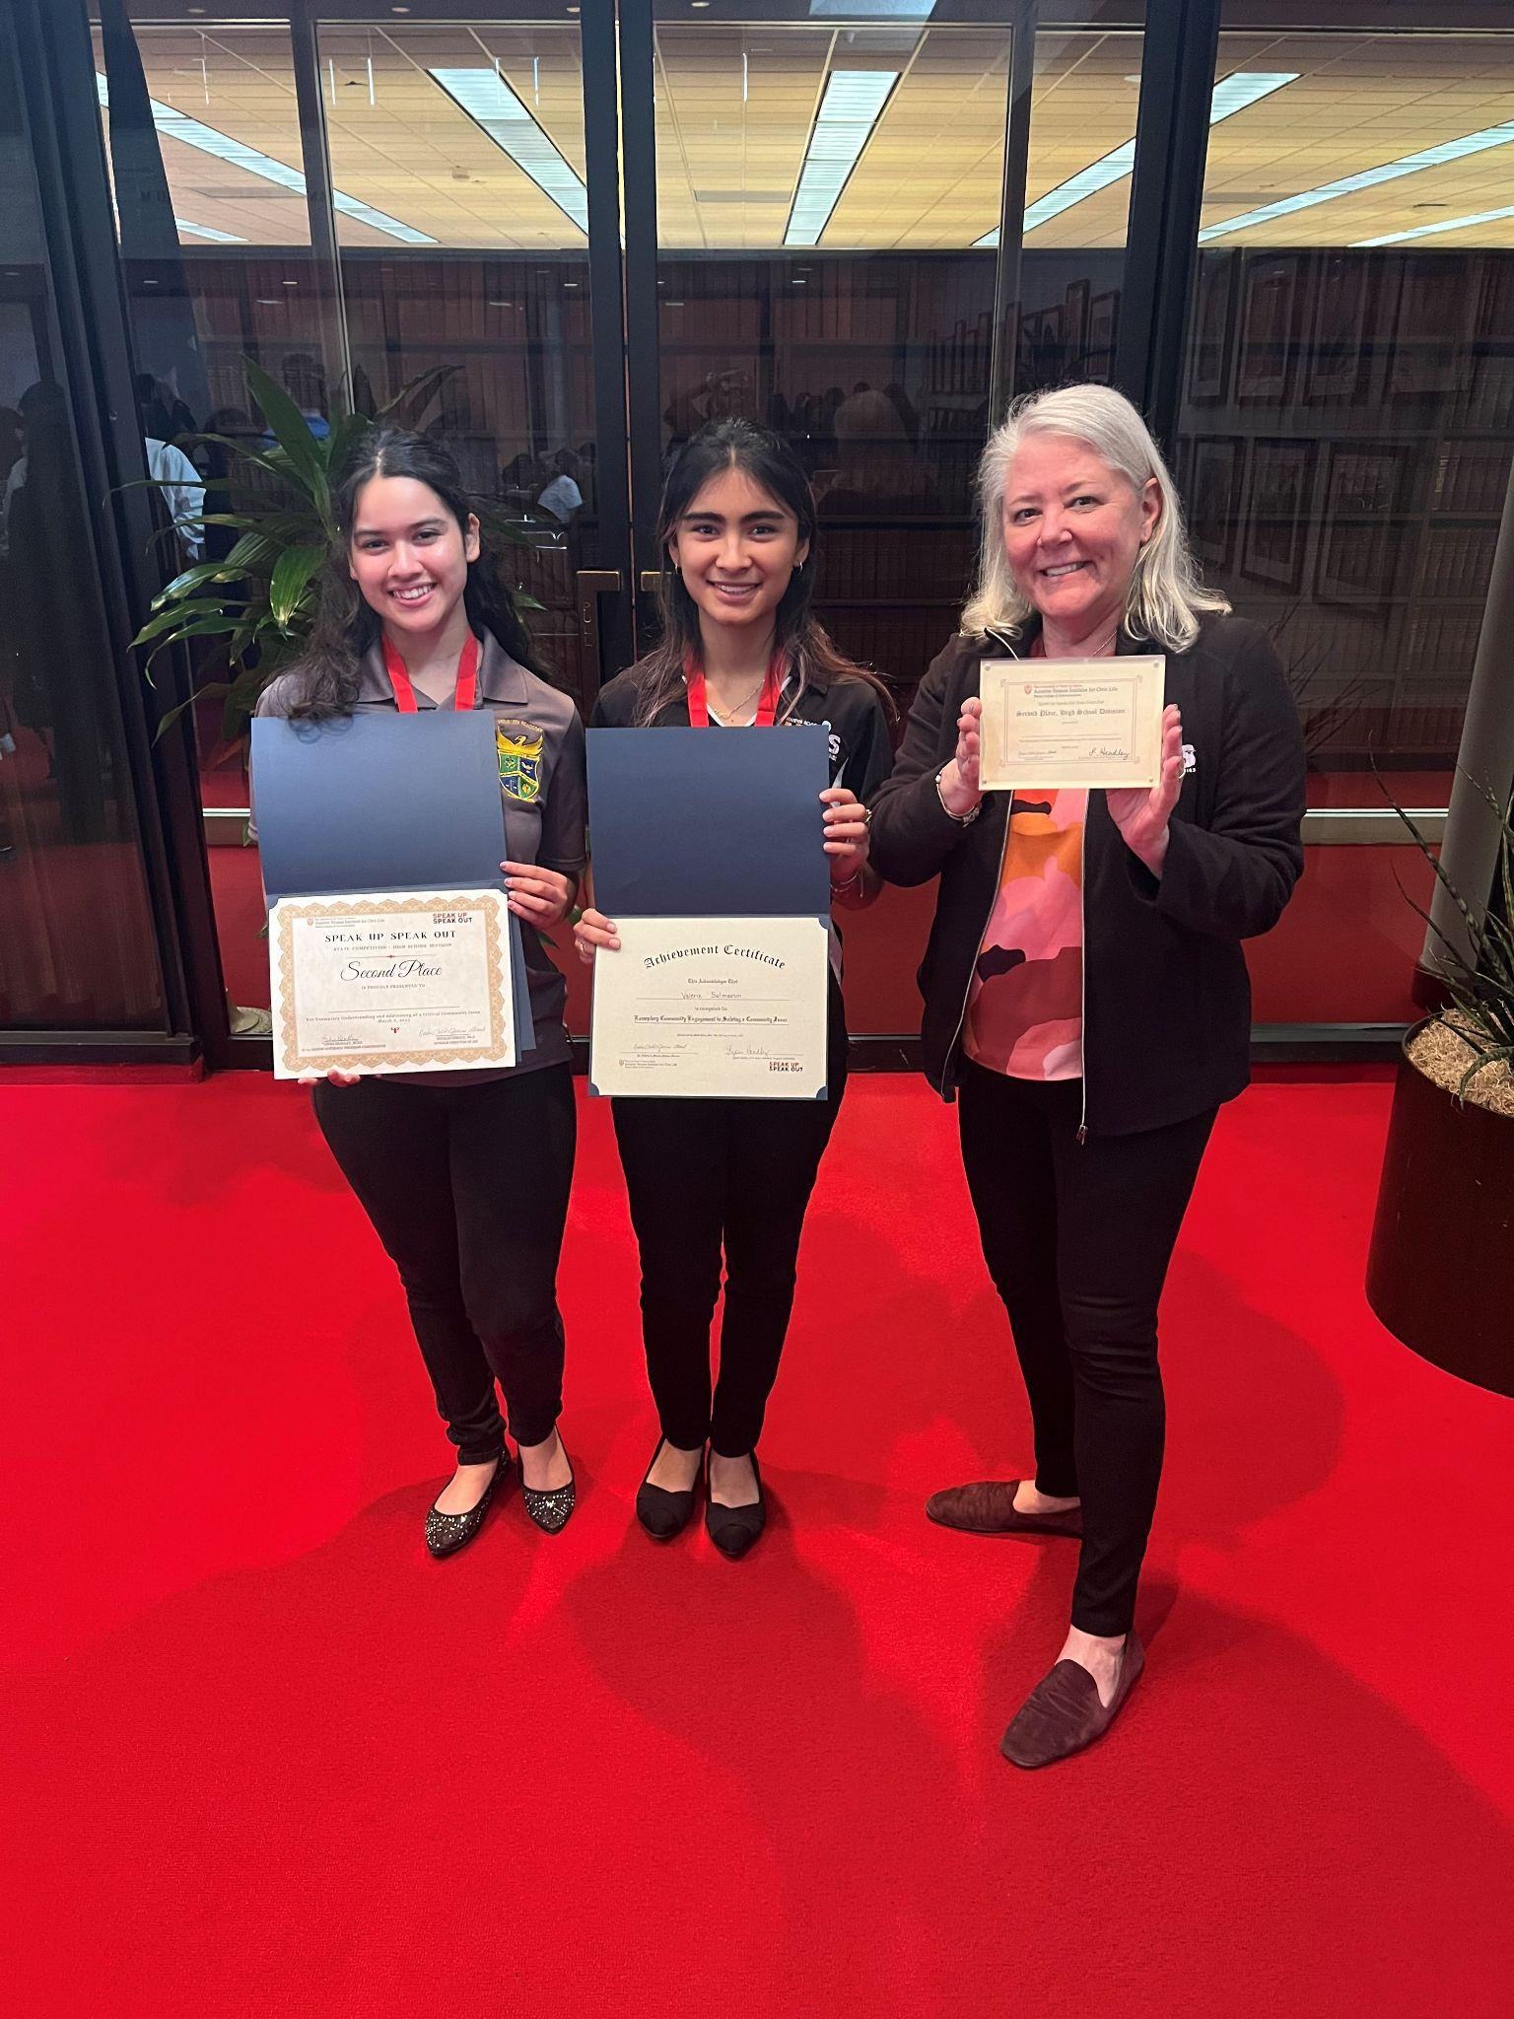
11th Grade Capstone
Service Learning Capstone (SLC)*
Speak Up, Speak Out
The Service Learning Capstone (SLC) is an exciting and challenging part of the Junior experience here at HAIS!
Students and a small group of peers will successfully complete a project that actively addresses an issue of social injustice in our community by investigating the depth and breadth of the issue, interviewing non-profits in the area, reaching out to City of Houston and Harris County officials who work to change the status quo, and completing a service project that responds directly to a challenge identified in your thorough research.
* Hours dedicated to the SLC can be used towards the 200 hour graduation requirement.
The Annette Strauss Institute for Civic Life at University of Texas - Austin, Speak Up, Speak Out program is a civic education program designed to teach students about their communities and equip them with the tools to make a difference.
Standout capstone teams are selected to submit videos fir the chance to represent HAIS at the Speak Up, Speak Out state civics fair in Austin, Texas.
2nd Place Winners at the 2023 State Civics Fair: Women and Elderly Homeless
Hillary Jasso & Valerie Salmeron
Coach: Ms. Shepard

Slide 11
HAIS Parent & Teacher Organization (PTO)
The HAIS PTO oversees various initiatives to support students, faculty, and staff at HAIS including:
Annual Halloween Dance
Teacher Appreciation
Sponsorship of Field Trips
Phoenix Festival
Join the HAIS PTO today!
Twitter:@HaisPto
Instagram: @haispto
Website: haispto.org
Upcoming Events

Slide 12
HISD Volunteers in Public Schools (VIPS)
We welcome parents and guardians here at HAIS!
Volunteers support the district’s main goal to positively impact student achievement. By serving as a mentor, tutor, chaperone, and role model you are supporting HISD students, parents, and the future generations of the Houston community.
Volunteer Onboarding consists of:
Online Registration
Complete the volunteer orientation
Undergo a background check
Sign up for campus volunteer assignments
Track your volunteer hours
To learn more and register for VIPs, please visit: https://bit.ly/3LZbO4e

Slide 13
Upcoming Opportunities
April 4: HAIS PTO Meeting (join in-person or virtual)
April 15: HAIS Earth Day Community Clean Up
Student volunteers register using Innerview
Parent/Guardians and Community members register here:
May 1: Class of 2023 Signing Day
May 6: Incoming Student Signing Day
Sign up to donate a Fri-Yay Treat.
Ways to Stay in the Know
Instagram
Twitter
Facebook
Campus Website
Weekly HAIS Newsletter

Slide 14
Together we foster World Class Citizens
Houston Marathon
Interact Club
Discover U
Camp Counselors
Notes:
Closing Thoughts: Accepting both 9th and 10th Graders

Slide 15
Questions?
Ms. Erica Alderete
Magnet Coordinator
ealderet@houstonisd.org
Follow Us:
IG: haisechs
Twitter: HAIS_ECHS
#RisingPhoenix

